Slide 1

Purple thinking
How adopting the hacker mindset has helped me as
a soc analyst
@GyledC

Slide 2
whoami
Melbourne-based (Australia, not Florida) Cyber Threat Analyst, Cyber Research New Zealand
BSides groupie – went to all the BSides conferences Down Under last year
Used to live out of a suitcase due to work but is now a happy home-based remote worker
Part of the 1st cohort of the Project Friedman, an initiative from AWSN (Australian Women in Security Network) and WomenSpeakCyber to encourage & support women to speak at tech & security cons
Firm believer in the IDIC principle (Infinite Diversity in Infinite Combination)

Slide 3
Lightning talk
What’s a SOC?
Blue team skill set
Blue + Red = Purple
Hacker Ethos

Slide 4
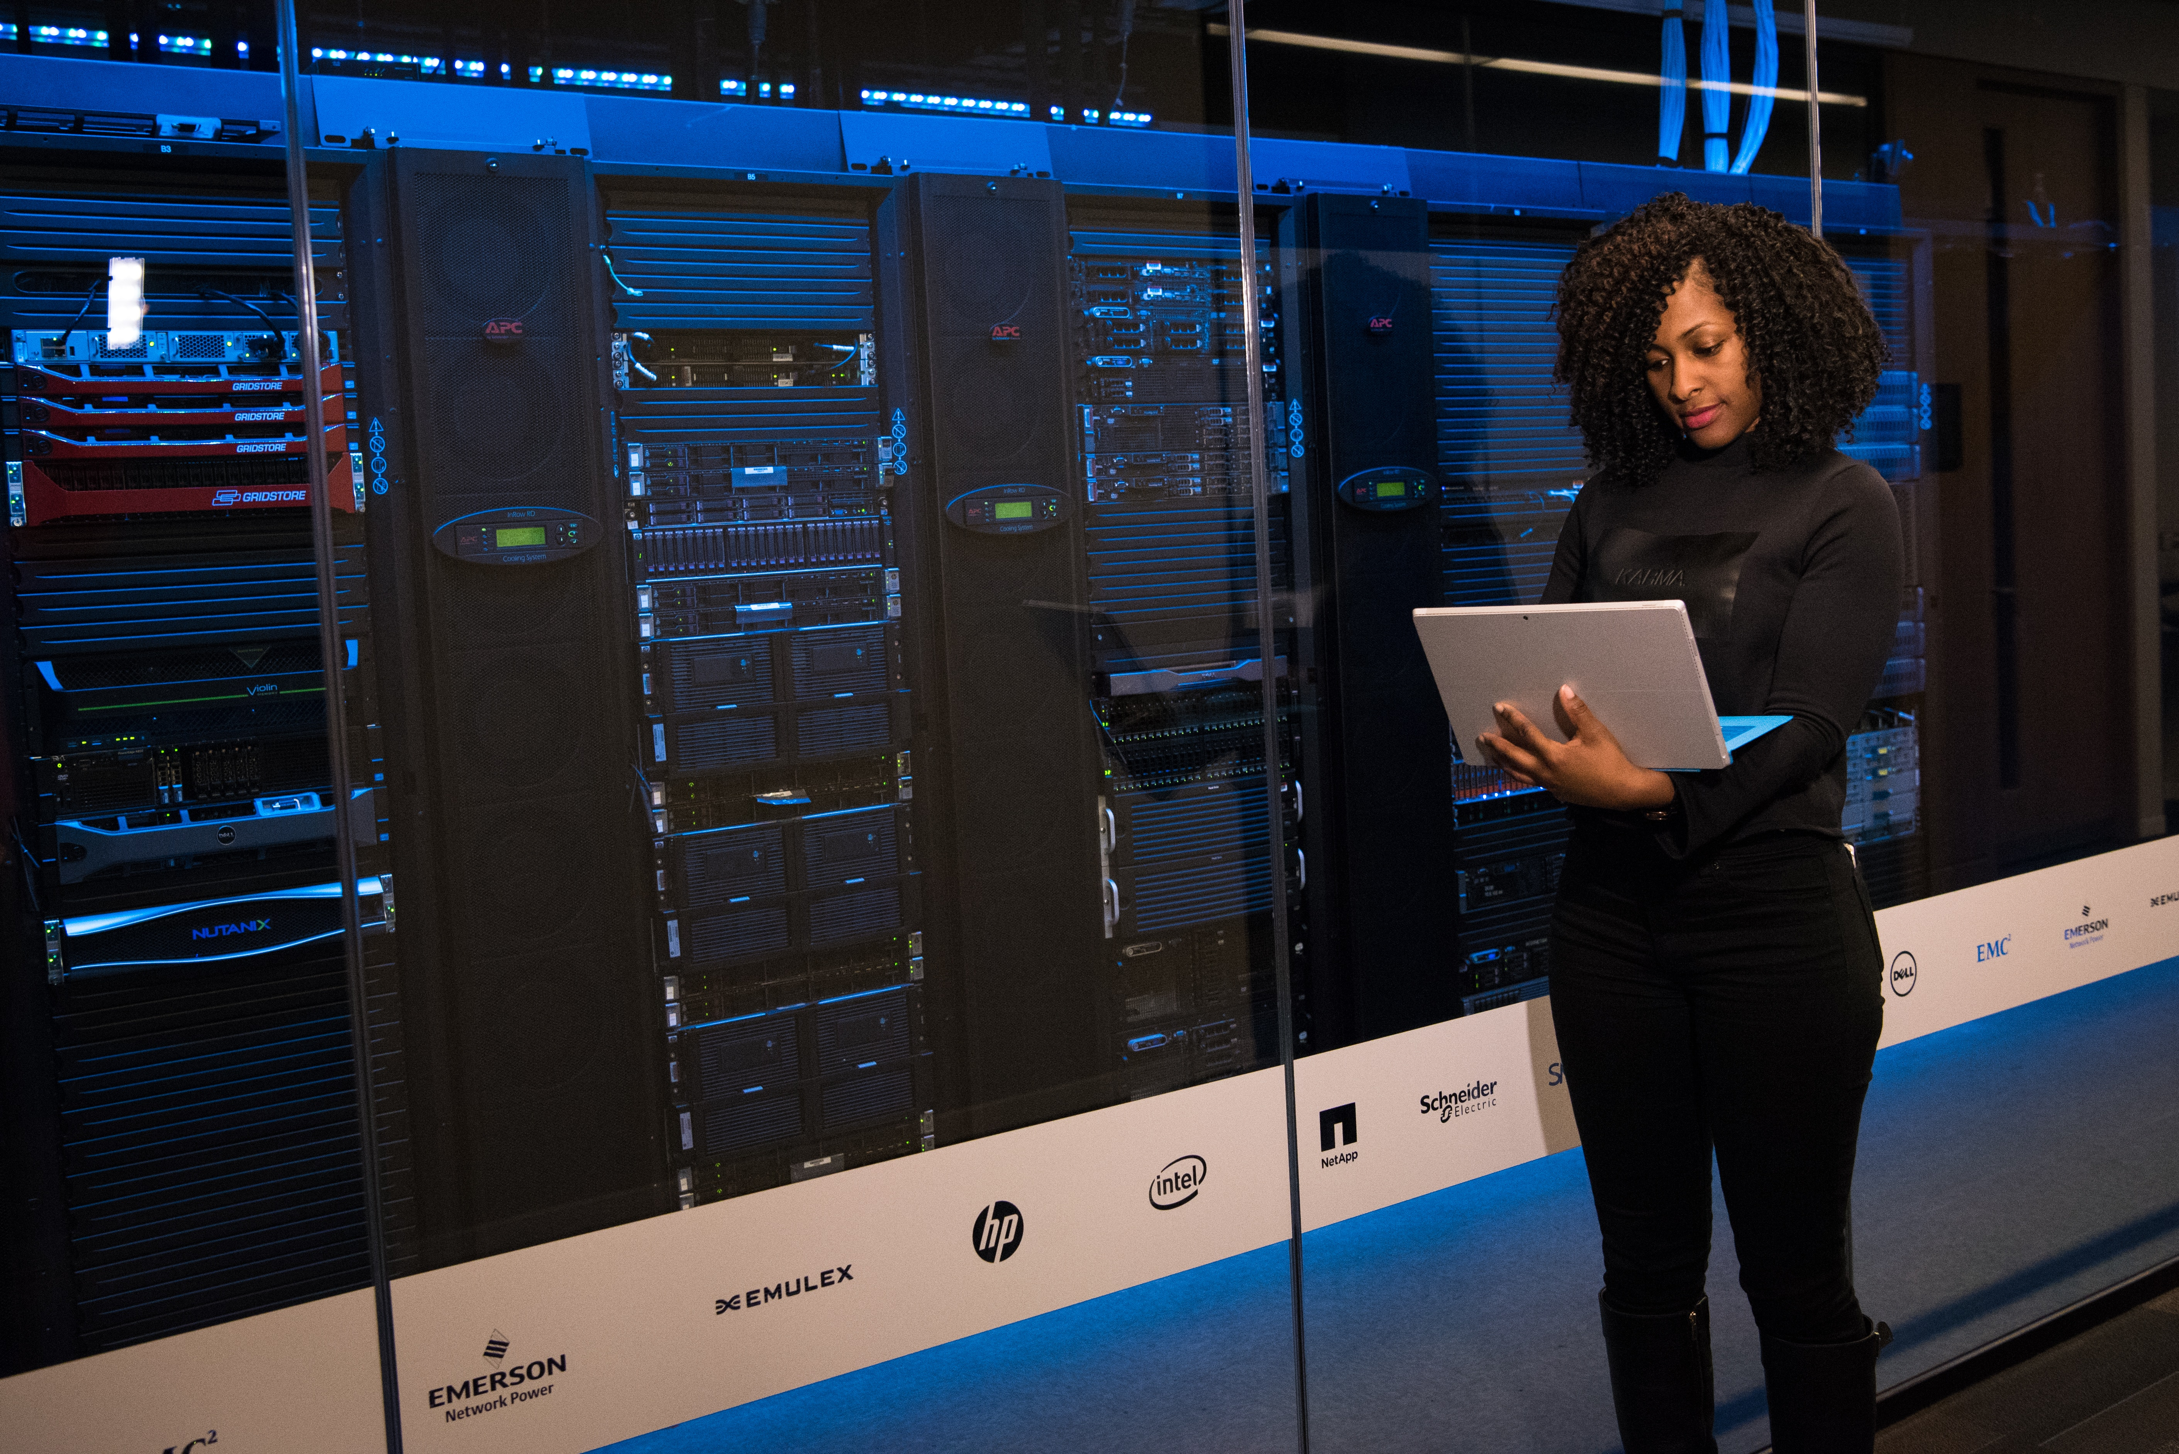
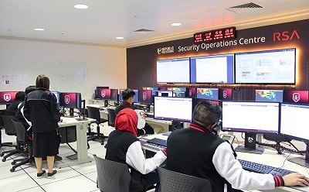
Pop quiz!
Photo by Christina Morillo from Pexels
Photo from Republic Polytechnic, Singapore

Slide 5
Essence of a Security operations center
Collection and analysis of data to detect suspicious activities
Responding to malicious activities
End goal: protection of the organization’s infrastructure/information assets
SOC functions are generally classified as blue team types of activities (defense)
MSSP – Managed Security Services Provider model:
SOC services for different clients in different industries.

Slide 6



bLUE TEAM skills set in a SOC
Host, server and network knowledge
Log/data analysis
Digital forensics
Incident response
Malware reverse engineering

Slide 7
RED + blue = purple
How my pentester teammates have influenced me:
Repurposing of certain hacker tools – Shout out to Bloodhound!
Think like an attacker when analyzing logs – JPCERT has a good tool analysis worksheet.
Make full use of the vulnerability management tools.
Demonstrate impact – First make sure that part of the client contract involves simulated adversarial activities. ;)
Be playful – How can we get in?

Slide 8
Hacker ethos
No judgement about race, sex, gender, academic background or position.
Commitment to transparency/openness – information is shared, most especially if it will help everyone.
Sharing of one’s talent/skills set to the community.

Slide 9
Links
Bloodhound link: https://github.com/BloodHoundAD/BloodHound
Tools analysis worksheet from Japan CERT: https://jpcertcc.github.io/ToolAnalysisResultSheet/
Image sources:
Woman in front of network/server racks:
Pexels - Christina Morillo: https://www.pexels.com/photo/woman-standing-while-carrying-laptop-1181354/
Also available from https://www.flickr.com/photos/wocintechchat
Diverse analysts inside a SOC: Republic Polytechnic of Singapore: https://www.rp.edu.sg/soi/about-soi/learning-facilities
Liam Neeson in Taken meme generator: https://imgflip.com/memegenerator/Liam-Neeson-Taken

Slide 10
Questions?
Please feel free to reach out/connect:
Twitter: @GyledC
LinkedIn: www.linkedin.com/in/gyledelacruz

